Slide 1

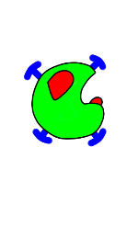
Deep-Learning-Based Assistant Fetching Robot
Department：Electrical Engineering
Grade：third
Name：UI-KAI Chen, KAI-CHU Chang, Hung-Yuan Yeh
Advisor: Ying-Jen Cheng Ph.D.

Slide 2
Outline
1.Introduction
2.Assistant fetching robot design
3.Experiment results
4.Conclusion
5.Future Work

Slide 3
1.Introduction
2.Assistant fetching robot design
3.Experiment results
4.Conclusion
5.Future Work

Slide 4
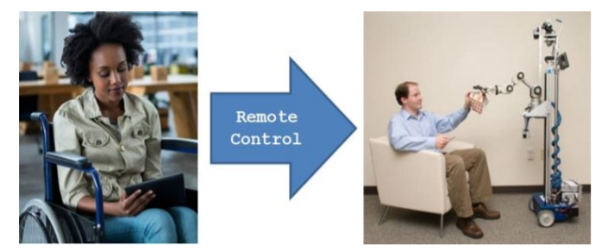
Introduction Purpose
User can control the robot by smartphone and select the object which you want to fetch, then the robot will fetch the object.

Slide 5
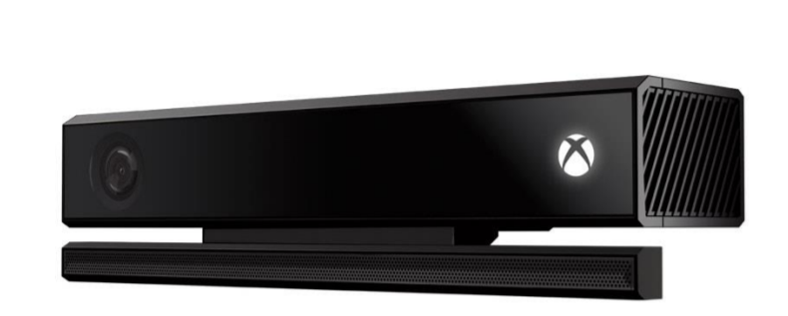

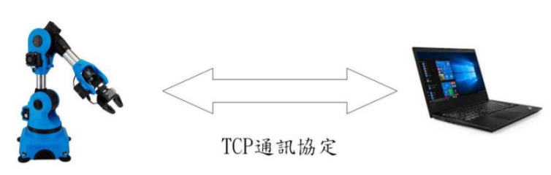
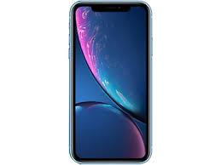

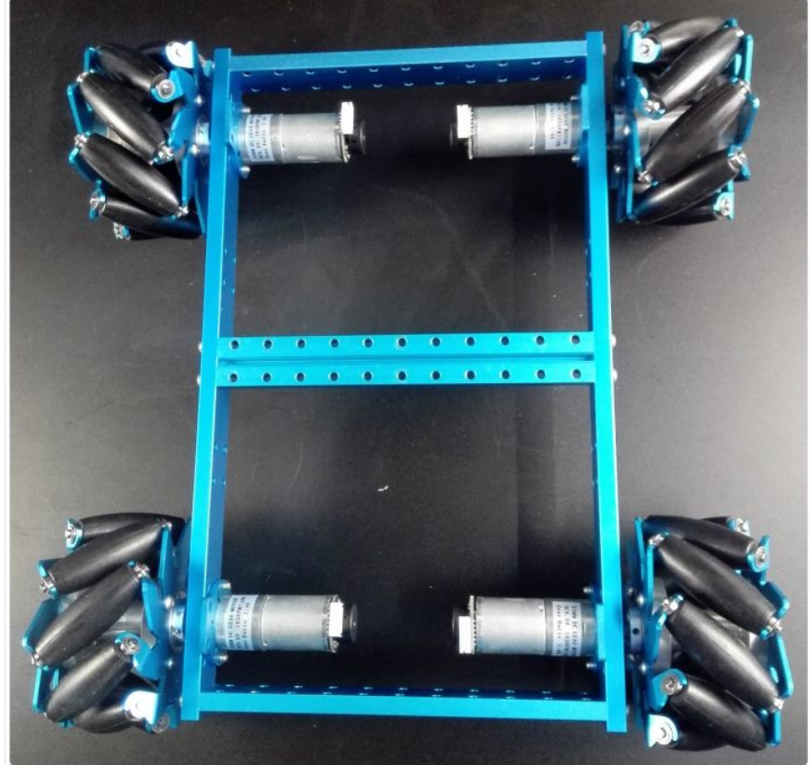

Introduction(conti.) System structure
RGB-D Data
TCP communication
Commands

Slide 6
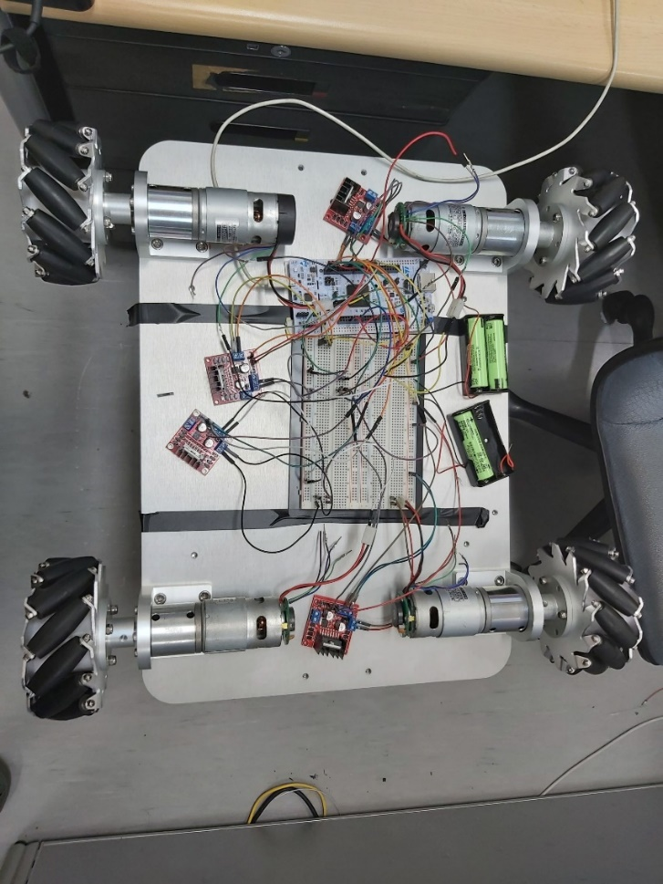
Introduction(conti.) Mobile platform
Use four Mecanum wheels and some motors as the moving system.

Slide 7
1.Introduction
2.Assistant fetching robot design
3.Experiment results
4.Conclusion
5.Future Work

Slide 8
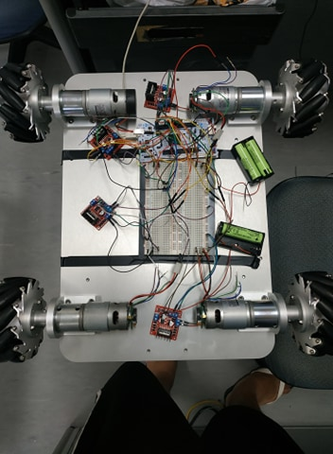
Assistant fetching robot design Mobile platform
L298N:
Motor driver
Motor
Main board

Slide 9
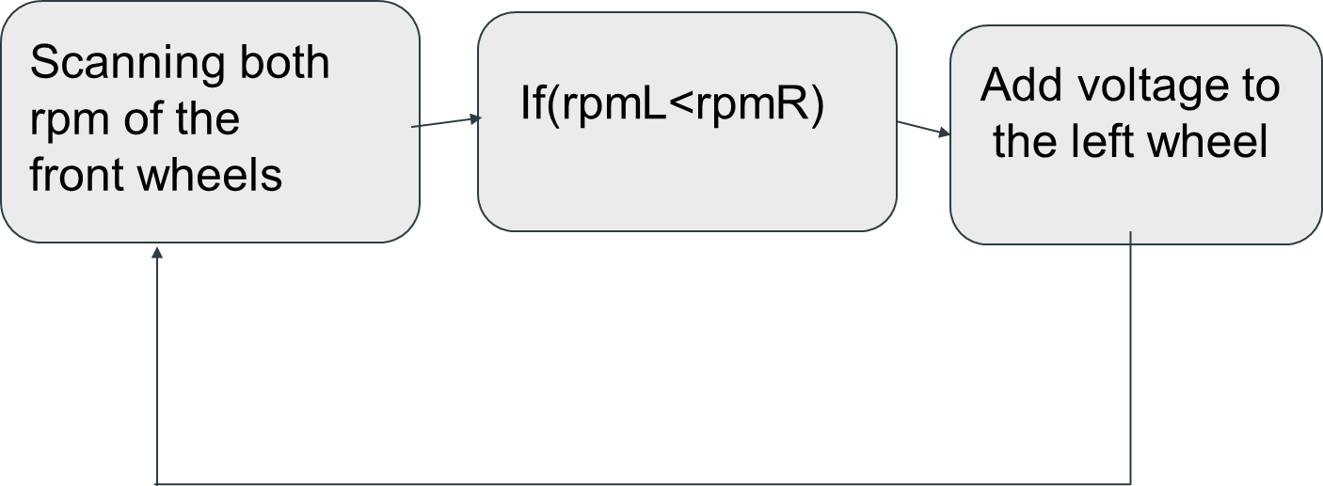
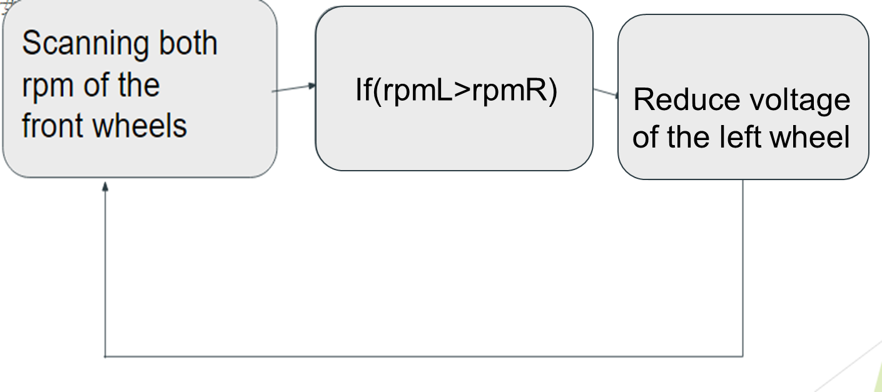
Assistant fetching robot design(conti.) Methods

Slide 10
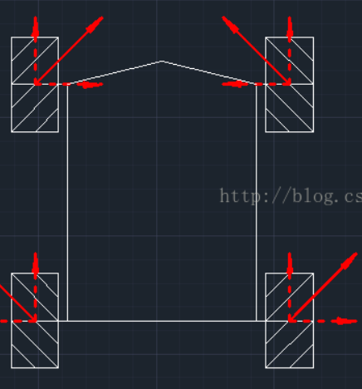
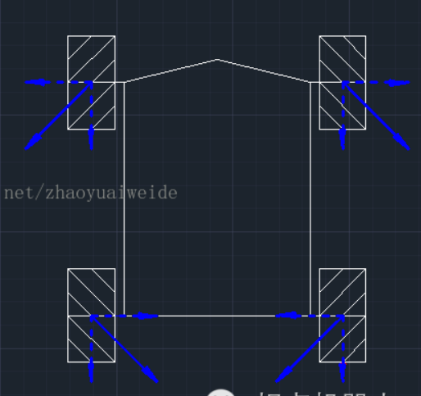
Assistant fetching robot design(conti.) Moving status(forward & backward)

Slide 11
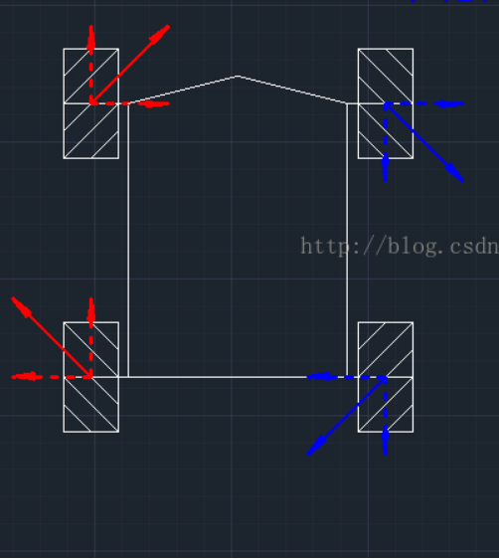
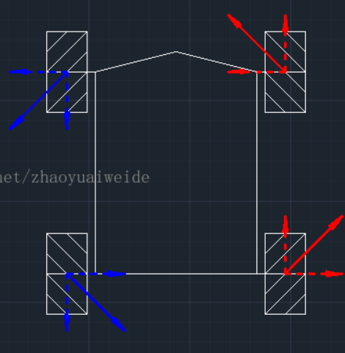
Assistant fetching robot design(conti.) Moving status(clockwise & counter clockwise)

Slide 12
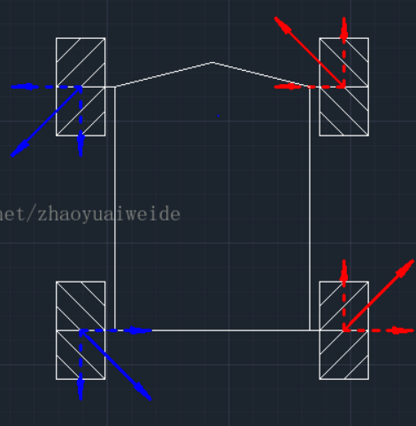
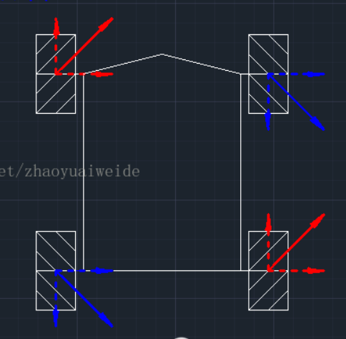
Assistant fetching robot design(conti.) Moving status(leftpar & rightpar)

Slide 13
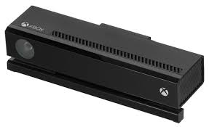
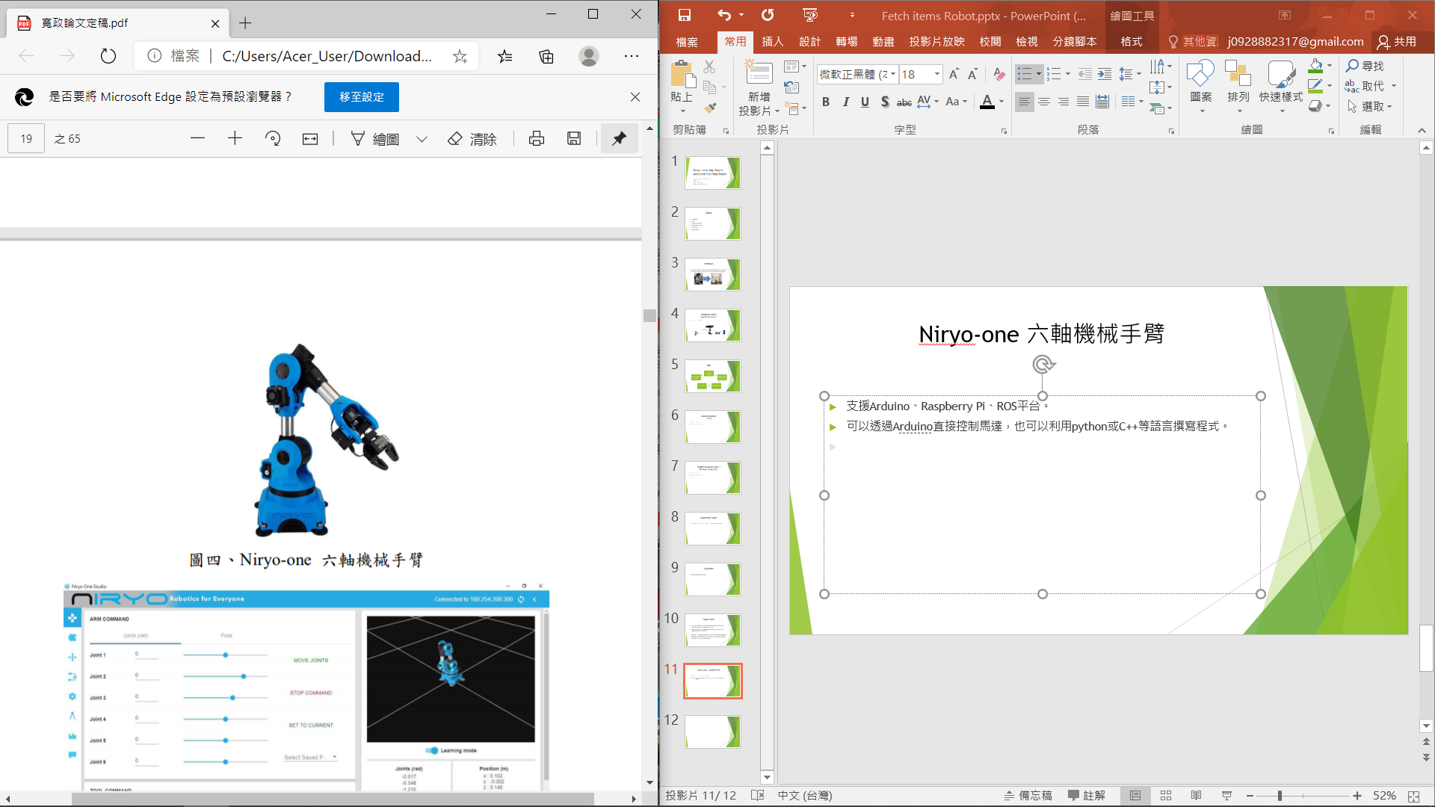

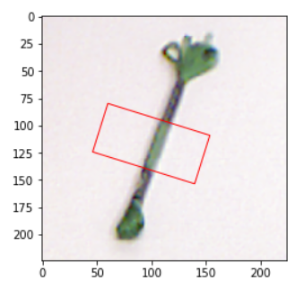
Assistant fetching robot design(conti.) Kinect and Deep-Learning algorithm to find the best grasp
Collect the
RGB-D data
Recognize object
Best grasp point
Grasp

Slide 14
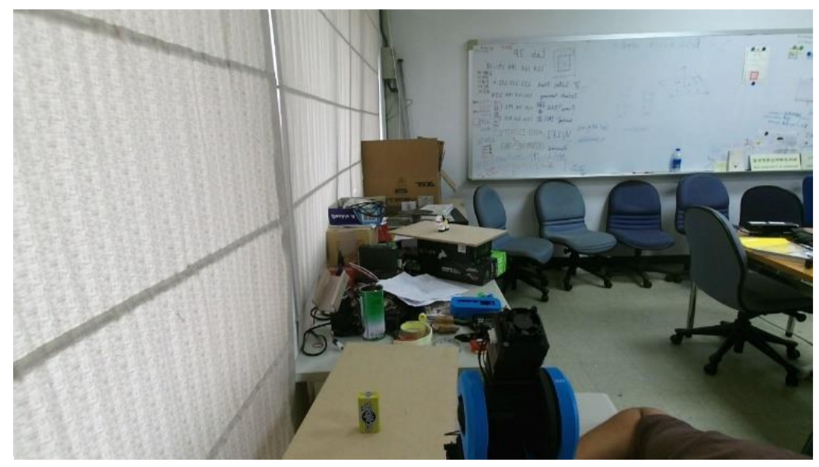
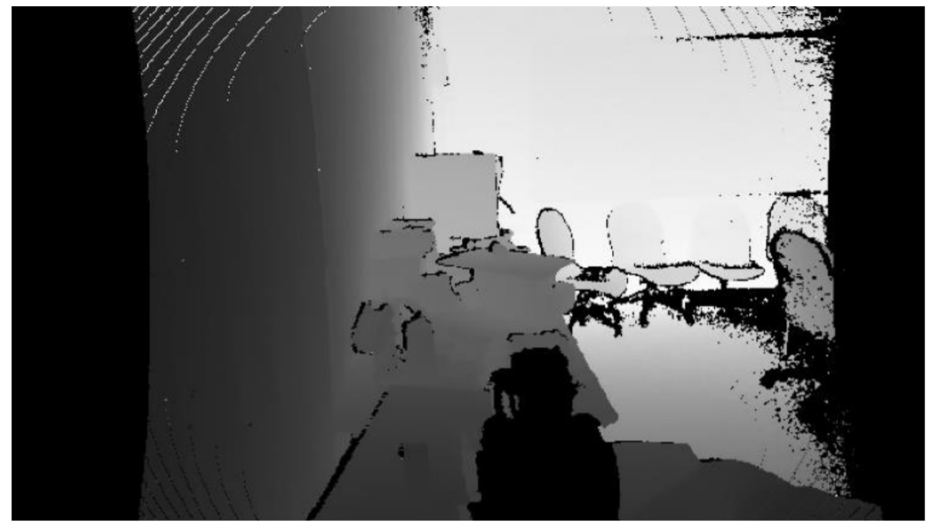
Assistant fetching robot design(conti.) Kinect
We apply C# to command Kinect for getting the RGB-D data
Converts the RGB data to JPG
Map the depth data to camera space, convert it to depth picture

Slide 15
Assistant fetching robot design(conti.) Kinect and Deep-Learning algorithm to find the best grasp
Collect the
RGB-D data
Recognize object
Best grasp point
Grasp

Slide 16
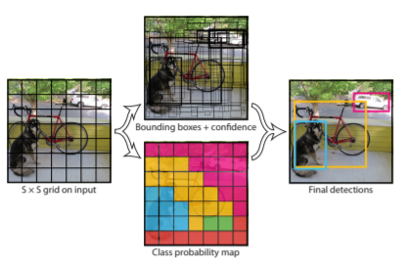
Assistant fetching robot design(conti.) YOLO

Slide 17
Assistant fetching robot design(conti.) Kinect and Deep-Learning algorithm to find the best grasp
Collect the
RGB-D data
Recognize object
Best grasp point
Grasp

Slide 18
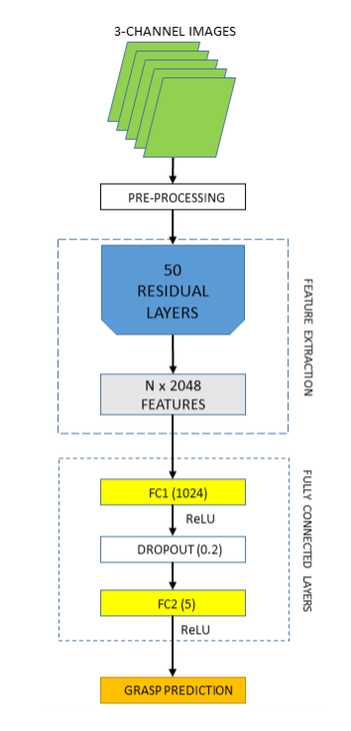
Assistant fetching robot design(conti.) Deep-Learning algorithm
Network structure
3 – Channel Image
ResNet
Full Connect Layers

Slide 19
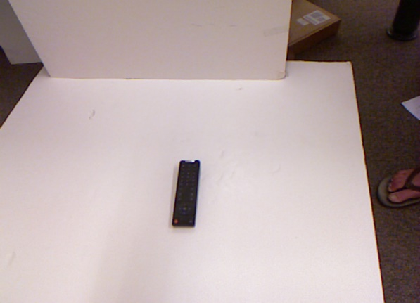

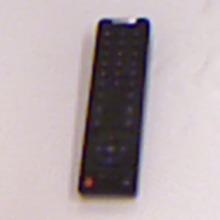

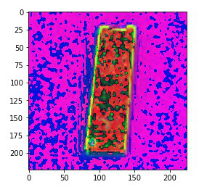
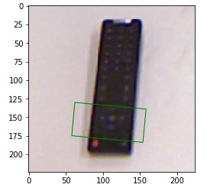
Assistant fetching robot design(conti.) Training Data Preprocessing
RGB and Depth
Input

Slide 20
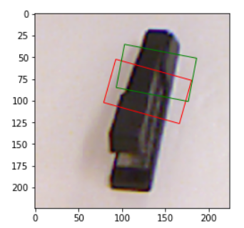
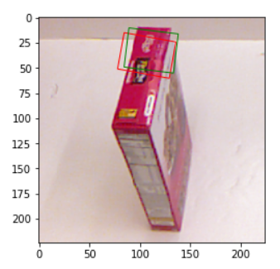
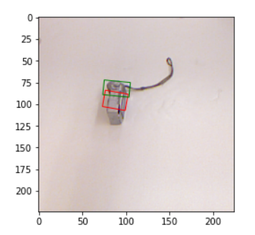
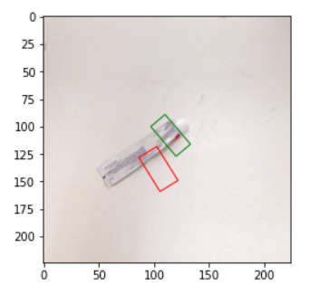
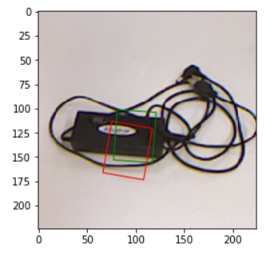
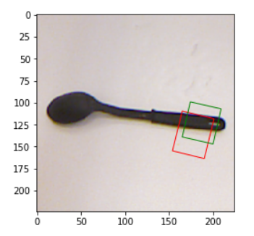
Assistant fetching robot design(conti.) Training Result
True positive
False positive

Slide 21
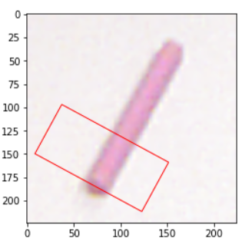
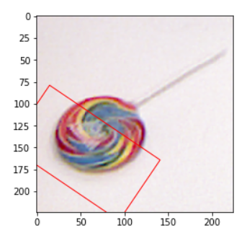
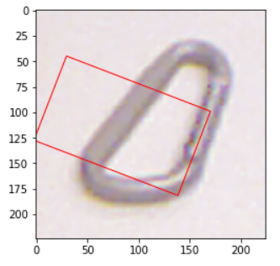
Assistant fetching robot design(conti.) Prediction Result

Slide 22
Assistant fetching robot design(conti.) Kinect and Deep-Learning algorithm to find the best grasp
Collect the
RGB-D data
Recognize object
Best grasp point
Grasp

Slide 23
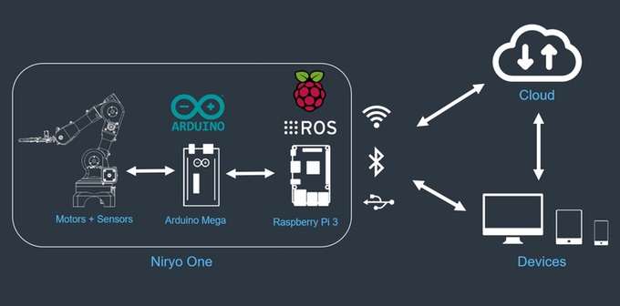
Assistant fetching robot design(conti.) Robotic arm control
It suppose to ROS, Arduino, and Raspberry PI.
We can control the arm through Arduino, Python and C++.

Slide 24
1.Introduction
2.Assistant fetching robot design
3.Experiment results
4.Conclusion
5.Future Work

Slide 25
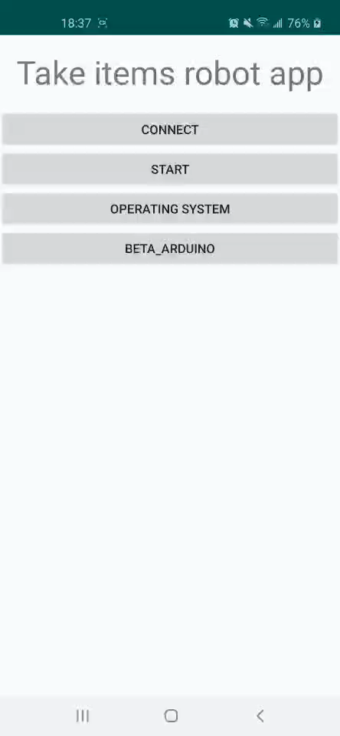
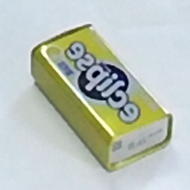

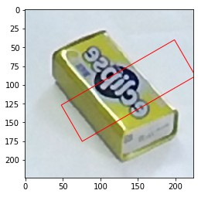
Experiment results APP

Slide 26
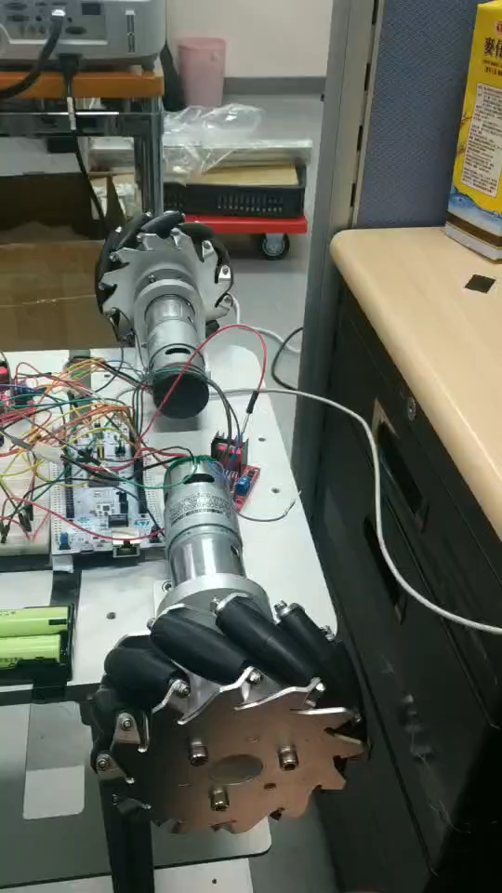
Experiment results(conti.) Mobile platform

Slide 27
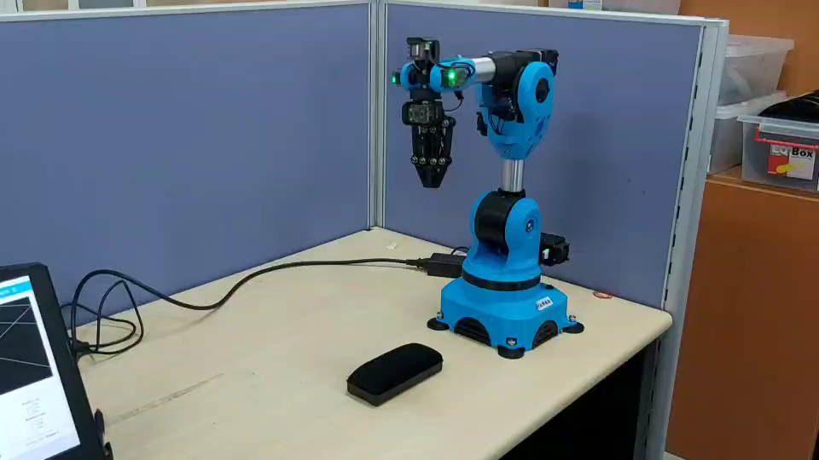
Experiment results(conti.) Niryo-one 6-Axes Robotic Arm

Slide 28
Outline
1.Introduction
2.Assistant fetching robot design
3.Experiment results
4.Conclusion
5.Future Work

Slide 29
Conclusion
The work we have finished:
Communication between smartphone and computer
Find the object’s recognized by YOLO and best grasp point
Realize grasping object through arm
Mobile platform control

Slide 30
1.Introduction
2.Assistant fetching robot design
3.Experiment results
4.Conclusion
5.Future Work

Slide 31
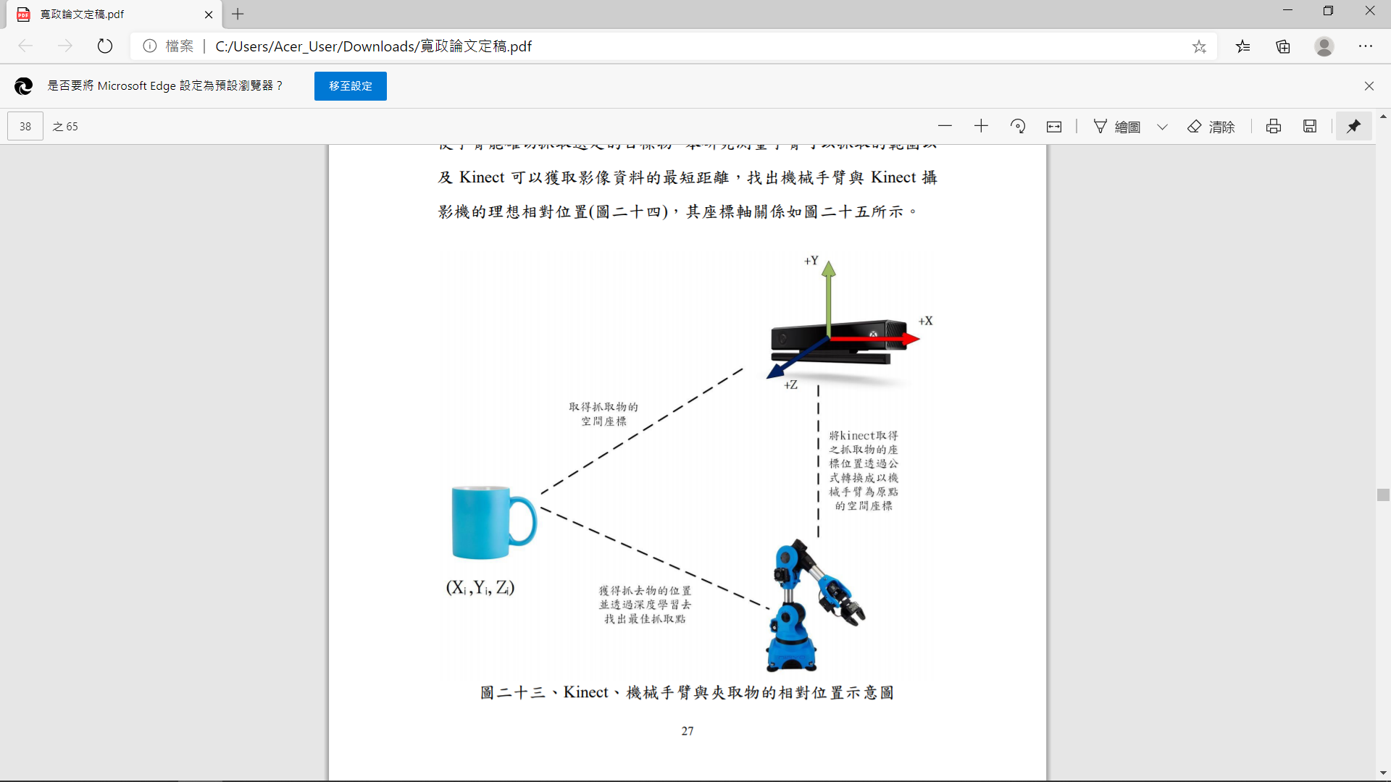
Future Work
Improve:
1.We can integrate the robot with arm, mobile platform and computer.
2.Due to the lack of training dataset about YOLO ,the robot recognizes only few objects.
In conclusion, We hope the system can be accessed to the people who moves with difficulties in the future. It can make the patients be more safe and convenient.

Slide 32
Thanks For Listening

